Slide 1
Course - DT228/1
Information Technology Fundamentals
INFORMATION TECHNOLOGY SECURITY

Slide 2
Information Systems in Organisations
An organisation is a person or group of people united for some purpose –
to deliver a product, a service, information...
Many organisations are established for trade – to generate profit, but not necessarily. They may be charities or government departments. They still need management and information systems!

Slide 3
Security
Integrated security and privacy requirements are critical to IT management and protecting an organisation’s information.
The organisation may be required by organisational policy or legal compliance to have an information security programme in place.
A security programme may be put in place to insure against identified problems or risks.

Slide 4
Security (2)
A security programme may be managed by named individuals in management positions in any part of the organisation.
The context of this presentation is information security cited with an IT Department of an organisation through the proper implementation of information systems.

Slide 5
Security (3)
The goal of a security programme is to provide assurance that there exists security to:
Provide for timely and reliable availability of information and systems
Preserve confidentiality of data
Safeguard integrity of data

Slide 6
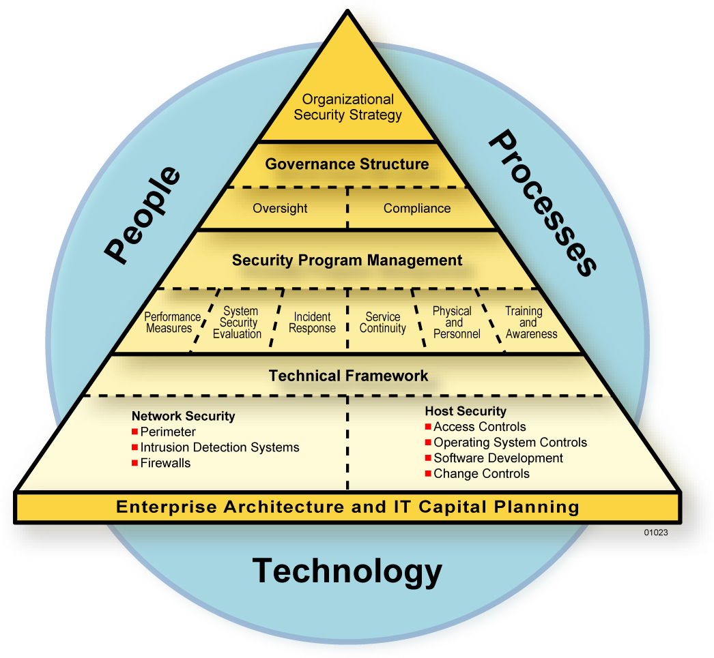
A Security Programme Combines People, Processes and Technology

Slide 7
Security Controls
A security control is a specific action or procedure that is provided to protect confidentiality, integrity and availability of information/systems.
Security controls - in International Organisation for Standardisation (for Technology)

Slide 8
Security Controls (2)
Management Controls
Focus on the management of the computer security system and the management of risk for a system.
Operational Controls
Focus on mechanisms that primarily are implemented and executed by people (as opposed to systems).
Technical Controls
Focus on security controls that the computer system executes.

Slide 9
Management Controls
Management Controls
The management of the computer security system and management of risk appears as policy in directives (documented) – so are written down somewhere.

Slide 10
Operational Controls
Operational Controls
Mechanisms implemented and executed by people are procedures that may follow from the Management Control policy documents.
The mechanisms need to be described – so are written down somewhere.

Slide 11
Technical Controls
Technical Controls
Security controls that the computer system executes might well be documented but, more importantly, can be coded into software.
Many software programs contain integrity (security) features or are designed specifically for security - providing diagnostics or providing solutions to security problems.

Slide 12
Security Types
To continue in an examination of the differences in the ‘controls’ let us take a look at three security types;
Physical controls
Administrative controls
Computational controls

Slide 13
Physical Controls
Physical security
These ensure that hardware is secure and check for equipment malfunction. May include access to hardware.
Example: the restriction of access to a computer room to operational personnel or the taking of back-up copies of files in case of accidents.
Hardware controls should take account of fire and environmental hazards.

Slide 14
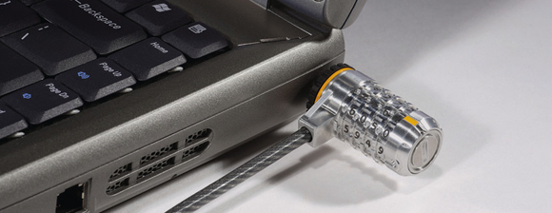
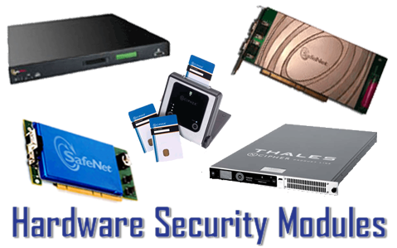
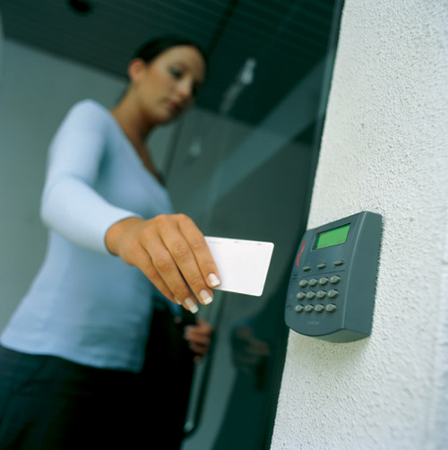
Physical Controls (2)

Slide 15
Administrative Controls
Administrative disciplines, standards and procedures
These are formalised standards, rules, procedures and control disciplines to ensure that the organisation's other controls are properly executed and enforced. Examples of these controls are:
segregation of functions
written policies and procedures
supervision

Slide 16
Administrative Controls (2)
Controls over the system implementation process
Implementation controls audit the system development process at various points in time to ensure that the project is being properly controlled and managed.
Example: a 'sign-off' at the end of each stage of the development process where a developer offers a section of the project to a user or manager to sign off, thereby documenting their approval of the development stage offered.

Slide 17
Administrative Controls (3)
Computer operations controls
These apply to the work of the computer department (EG the IT Department) and help to ensure that programmed procedures are consistently and correctly applied to the storage and retrieval of data.
Example: controls over set-up, operations software, computer operations and backup and recovery procedures.

Slide 18
Computational Controls
Software controls
These monitor the use of system software and prevent unauthorised access to software programs.
Internal system security
Data security controls
Application controls
Specific controls within each computer application. Include automated and manual procedures that ensure that only authorised data are processed by a particular application.

Slide 19
Computational Controls (2)
Application controls are usually in one of three categories:
Input controls
Processing controls
Output controls

Slide 20
Issues and Considerations of Security Management
Access control
Awareness and training
Audit and accountability
Certification, accreditation, and security assessments
Configuration management
Contingency planning
Identification and authentication
Incident response

Slide 21
Issues and Considerations of Security Management (2)
Maintenance
Media protection
Physical and environmental protection
Planning
Personnel security
Risk assessment
System and services acquisition
System and communications protection
System and information integrity

Slide 22
Viruses
A computer virus is a piece of programming code inserted into other software programs to cause some unexpected and, for the victim, usually undesirable event.
This code is a self-replicating or self-reproducing automation program that spreads by inserting copies of itself into other executable code, files or documents.

Slide 23
Viruses (2)
The files or code that the malicious code is affected by is, in a computer technician’s terms, said to be ‘infected’ because the idea of self-replicating code is similar to the description of a biological infection.
The ‘infected’ file is usually called the ‘host’.

Slide 24
Viruses (3)
Viruses can be transmitted when using the Internet by downloading programming from other Internet sites. In other cases the viral software might be present on a disk or flash memory.
The systems software supporting the file you are downloading (or disk you have received) does not often have the ability to detect the virus.

Slide 25
Viruses (4)
The virus lies ‘dormant’ until circumstances cause its code to be executed by the computer.
Some viruses are playful in intent and effect, signing "Happy Birthday" on the screen, for example.
Some can be quite harmful, erasing data or causing your hard disk to require reformatting.

Slide 26
Classes of Virus
Generally, there are three main classes of viruses:
File infectors
System or boot-record infectors
Macro viruses

Slide 27
File Infectors (Program Viruses)
These viruses attach themselves to program files, usually selected .BIN, .COM, .EXE, .OVL and .DRV files.
Some can infect any program for which execution is requested, including .SYS, .OVL, .PRG, and .MNU files. When the program is loaded, the virus is loaded as well.

Slide 28
System or Boot-Record Infectors
On hard disks, the first sector is called variously the master boot record, the partition sector, or the partition table.
This record or table tells how and whether the disk has been divided into logical partitions.
For example, you can divide your hard drive into two logical partitions or drives so that you can load different operating systems on to the disk and switch back of forth.

Slide 29
System or Boot-Record Infectors (2)
The virus software performs the task of overwriting the boot sector of the infected disk.
In some cases the virus will move information on the boot sector – either to make room for itself or so that boot sector files cannot be found by the system software – or the effect might be both of these things.

Slide 30
System or Boot-Record Infectors (3)
The general picture of how these infectors work is this:
When your operating system is being booted or loaded into RAM then a program in this partition sector briefly gets control and determines how your disk is partitioned.
It reads the operating system boot sector and gives that boot sector program control so that the rest of the operating system can be loaded into RAM.

Slide 31
System or Boot-Record Infectors (4)
When your operating system is running, files on the disk can be read without triggering the boot disk virus.
However, if a boot disk virus is loaded, it will make it temporarily impossible to use your hard disk.
Recovery may take several days. If your system is susceptible to this sort of virus you need full (all file) backup.

Slide 32
Macro Viruses
These are among the most common viruses, and they tend to do the least damage.
As an example: a macro virus infecting your Microsoft Word application might typically insert unwanted symbols, words or phrases.

Slide 33
Types of Virus
There are many types of software virus. Examples:
Companion
Trojan (horse)
Worm

Slide 34
Companion
A ‘companion’ is a viral program that does not actually attach to another program, but it uses a similar name and the rules of program precedence to associate itself with the proper program.

Slide 35
Trojan (horse)
A trojan is a program that pretends to have useful or desirable features - but actually contains a damaging payload which is the program within. There are sub-types of trojan, such as the ‘logic bomb’ which activates on particular keystrokes or the running of particular tasks.
The ‘time bomb’ activates at a particular time – usually by using information from the computer’s clock and calendar.

Slide 36
Worm
A worm is a virus that spreads by creating duplicates of itself on other drives, systems, or networks. An example is an e-mail that sends a copy of itself to all the addresses in your e-mail address book when you open the attachment.

Slide 37
Viruses on the Internet
Web viruses
In the case of a web virus and in order to copy itself to a new Web page, the HTML virus must execute on a machine from which it is allowed to change the page. HTML can link to virus code.
Technically, the viruses resemble normal programs.

Slide 38
Viruses on the Internet (2)
Can it read your files? Yes.
Can it format your hard drive? Yes.
A web virus is, essentially, a macro virus, the viruses - often written in VBScript - are embedded in the HTML included in a Web page or e-mail. (It would appear, from experience, that most ‘web viruses’ come through e-mail.)

Slide 39
Viruses on the Internet (3)
Viruses, in the last few years, have been hidden in e-mails, such as ‘Waledac’ and ‘VBMania’ (plus versions of the MyDoom worm).
Virus programs can have alternative names – aliases. Many web viruses have an alias to reduce immediate detection.

Slide 40
Protecting Your System
The best protection against a virus is to know the origin of each program or file you load into your computer.
Since this is difficult, you can buy anti-virus software that typically checks all of your files periodically and can remove any viruses that are found.

Slide 41
Warnings
From time to time you may get an e-mail message warning of a new virus.
It used to be usual that e-mail warnings were hoaxes, and many e-mail warnings are, but these days the possibility is that a virus is ‘making the rounds’ and some friendly postmaster is trying to stem the flow of problem e-mails.

Slide 42
Diagnostics
Software to identify and remove any type of virus continues to be the best defence for PC and Mac users.
Many ‘anti-virus’ software also detect trojans, worms, spyware, etc…

Slide 43
Anti-Virus Software
Anti-virus software is sophisticated, but virus writers are often a step ahead of the software, and new viruses are constantly being released that current anti-virus software cannot recognise.
Anti-virus software must be constantly updated with new lists of viruses.

Slide 44
Anti-Virus Software (2)
The key to anti-virus software is detection.
Once an infected file has been detected, it can sometimes be repaired. If not, the file can at least be quarantined so that the viral code will not be executed.

Slide 45
Anti-Virus Software (3)
There are four major methods of virus detection in use today:
scanning,
integrity checking,
interception and
heuristic detection.
Of these, scanning and interception are very common.

Slide 46
Anti-Virus Software (4)
Virus writers have attempted to defeat the software in their viruses, either by disabling the software or getting around the detection algorithms.
Polymorphic viruses attempt to neutralize virus-scanning techniques by changing the code every time the virus infects a new computer.

Slide 47
Up Next
Next week’s lecture title is:
User Centredness

